Slide 1
The ACORN Wholesale Collaborative
A Presentation to
The High Meadows Fund,
The John Merck Fund and
The Vermont Community Foundation
Tuesday, October 12, 2010

Slide 2
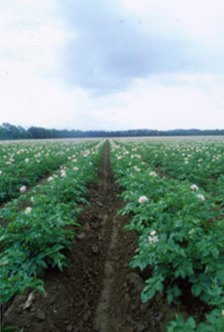
The ACORN Wholesale Collaborative
ACORN Background
The Local Food Market
The ACORN Wholesale Collaborative
AWC Strategy
Our Partners
AWC Team
Plan and Budget
Funding Request
Outcomes
Next Steps

Slide 3
ACORN Background Who we are
Started in 2005 -Community Response to Peak Oil
Strategic Focus - Developing local and sustainable sources of food and energy
Acorn Energy Co-op was spun off and incorporated in 2008
ACORN Network was incorporated and received 501(c)(3) status in 2009
All projects have been implemented by an all-volunteer board; no paid staff
ACORN has successfully sought collaborations with other area organizations to get projects done
ACORN has used creative market incentives to catalyze projects
A periodic e-newsletter is distributed to 630 persons

Slide 4
ACORN Food Projects: 2006-2010 What We’ve Done
2006
First Annual Eat Local Challenge
2007
Launch of Addison County Farmers Directory and Online Addison County Farmers Market
2008
Launch of Middlebury Winter Market and Tour de Farms
Addison County Conservation Congress – Vision 2020 for food and farming
2009
Co-sponsored Local Food Summit with MNFC
Invited to join Vermont Regional Food Centers Collaborative
Formed Addison County Local Foods Collaborative; received Farm Viability Program Grant to develop Strategic Local Food Plan for the county
Co-hosted regional Farm to Plate meeting
2010
Organized Stone Soup Conference with Vermont FEED
Published first Addison County Guide to Local Foods with Addison Independent
Published Strategic Food Plan introducing the ACORN Wholesale Collaborative idea
Hired part-time county farm-to-school and ACORN coordinator

Slide 5
The Local Food Market
Direct markets are approaching saturation
Increasing local food demand from institutions
Local food affordability
Institutions must deal with multiple growers
No incentive for growers to increase production and to specialize
No food processing hub in the county

Slide 6
ACORN Wholesale Collaborative
Low cost link connecting growers and buyers
Organized as a brokerage
Direct delivery service
One-stop ordering and billing
Online marketing and information sharing
Experienced coordinator building relationships
Vehicle for developing new markets

Slide 7
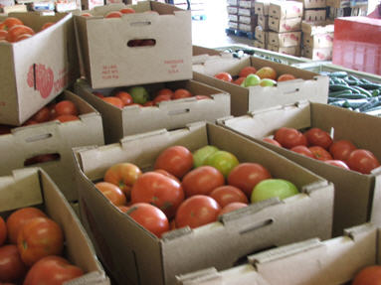
AWC Strategy
Non-profit status
Builds on existing infrastructure
No investment in assets
Relationship marketing
Comprehensive online ordering system
Tracking system for traceability
Potential for storage and season extension
Aggregation hub and delivery routes are scalable
Financially sustainable by year three

Slide 8
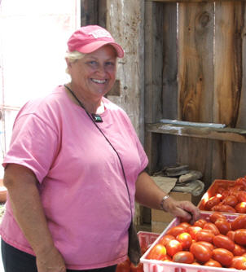
Our Partners
Growers who currently have on-farm capacity to wash, pack and store produce
Local delivery partner
Local aggregation and storage facility
Institutional buyers
Existing online “farm to market” platform

Slide 9
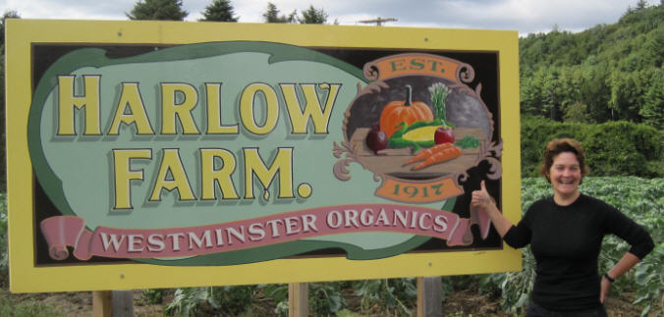
AWC Team
Market Manager – Annie Harlow
15 years Experience in all aspects
of food distribution and marketing
Founding Board
Jonathan Corcoran
ACORN president, author of strategic food plan, social and business entrepreneur
David Dolginow
ACORN Board Member, recent Middlebury grad, experience at Golden Russet, hired as coordinator at VRS
Rich Carpenter
ACORN Treasurer, experienced entrepreneur, participated in nearly twenty technology startups throughout his career

Slide 10
First Year Plan
First Year
10 growers
6 buyers including Middlebury College, Porter Hospital, Greg’s Meat Market, schools, corporate school food services, senior residences
20 to 30 total SKUs ; over 6,000 cases sold;
Total Sales = $151,000
Brokerage fees = $26,500
Piggyback on existing delivery routes and storage space
Champlain Orchards
Vermont Refrigerated Storage
One Paid Staff as Market Manager
Piggyback on Harvest to Market Online Ordering System

Slide 11
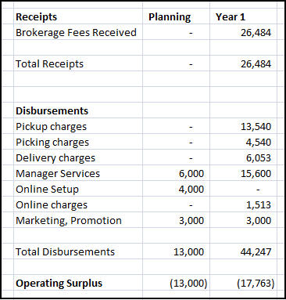
Financial Plan – 1st Year

Slide 12
Years Two and Three
Assumption | Year 2 | Year 3
Number of Growers | 20 | 30
Number of Buyers | 12 | 22
Number of SKUs | 30 to 40 | 50 to 75
Staffing – FTE | 0.5 | 0.6
Number of Cases Sold | 13,700 | 29,500
Product Value Delivered | $343,000 | $739,800
Brokerage Fees Received | $54,900 | $110,900

Slide 13
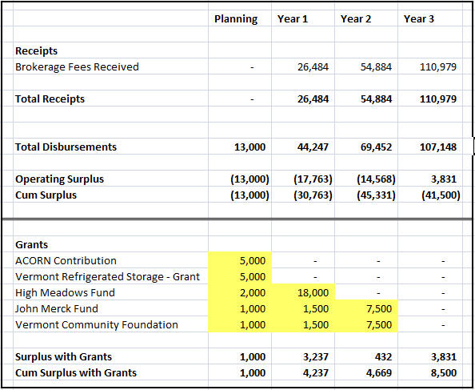
Funding Request

Slide 14
Outcomes of AWC
More local food is consumed in the county
New markets are opened for smaller growers
Larger institutions achieve goal of increasing local food purchasing
Market evolves toward contracted agreements between institutional buyers and growers
Processing opportunities are available to benefit both growers and buyers
Growers are incented to grow new crops

Slide 15
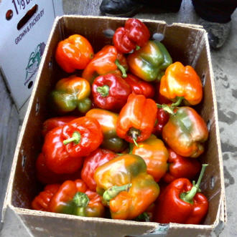
Next Steps
Discuss proposal today
Follow-up meetings with partners
Fine-tune financial model and budget
Prepare proposal for submission October 22
Launch AWC on 12/1/10

